Slide 1

Web Scraping to gain company insights
For Forage Virtual Internship

Slide 2
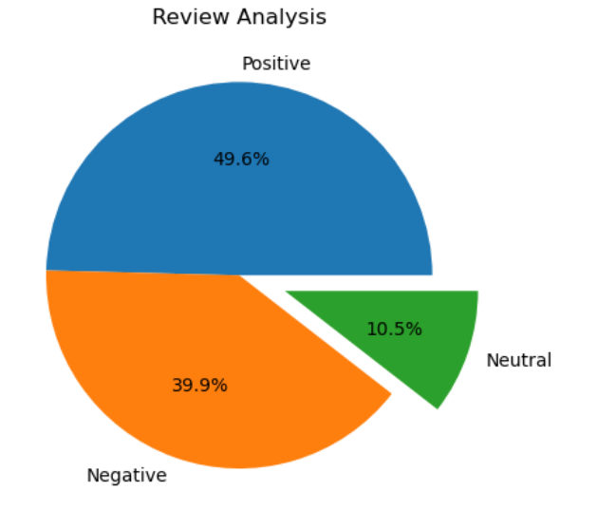
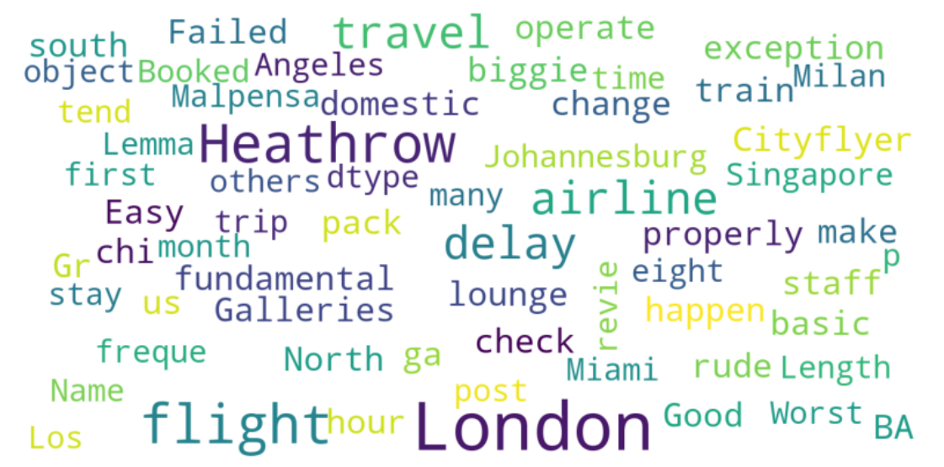
Analysis Of Customer Reviews
After Reviewing 100 reviews given by the customers, we obtained
Positive Reviews : 496
Negative Reviews : 399
Neutral Reviews : 105
WordCloud Obtained:

